Slide 1
Overview of Serial Protocols
Dr. Frank Walsh
IoT Protocols
WIT

Slide 2
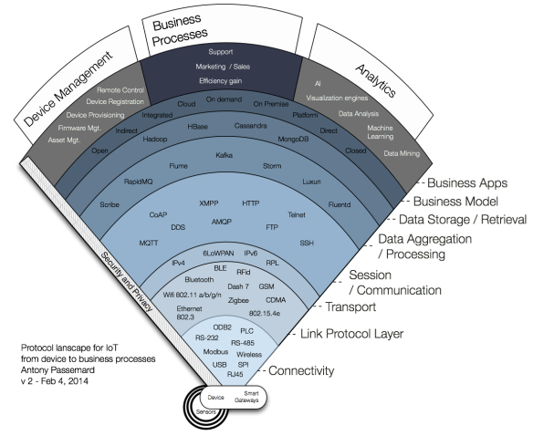
We’re focussing here…

Slide 3

Communication Protocols for Circuits: Introduction
Embedded electronics requires interlinking circuits (processors or other integrated circuits) to swap their information.
Required to have a common communication protocol
Lots of communication protocols developed
Generally classified into two categories:
  Serial
  Parallel
Serial comms often referred to as serial bus

Slide 4
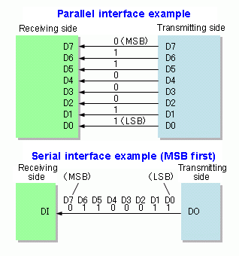
Parallel & Serial
Generally 2 types of communication system that transfers data between components inside a computer or between computers
  Parallel
  Serial
Parallel is simplest to implement but takes up a lot of hardware ‘real estate’
Serial requires fewer lines to transmit data but this adds complexity.
  Synchronous – uses clock
  Asynchronous – no clock but speed (baud rate) agreed before transmission.
We’re going to look at serial communication protocols.
Notes:
Parallel interfaces transfer multiple bits at the same time. Transmitting across eight, sixteen, or more wires. Data is transferred in huge, crashing waves of 1's and 0's.
Serial interfaces stream their data, one single bit at a time. These interfaces can operate on as little as one wire, usually never more than four.
Think of the two interfaces as a stream of cars: a parallel interface would be the 8+ lane mega-highway, while a serial interface is more like a two-lane rural country road. Over a set amount of time, the mega-highway potentially gets more people to their destinations, but that rural two-laner serves its purpose and costs a fraction of the funds to build.
Parallel communication certainly has its benefits. It's fast, straightforward, and relatively easy to implement. But it requires many more input/output (I/O) lines. If you've ever had to move a project from a basic Arduino Uno to a Mega, you know that the I/O lines on a microprocessor can be precious and few. So, we often opt for serial communication, sacrificing potential speed for pin real estate.

Slide 5
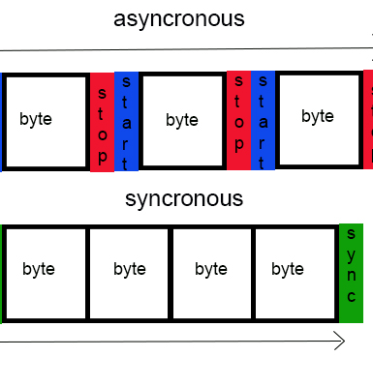
Synchronous and Asynchronous Serial
Known serial interface in embedded systems
  Universal Serial Bus (USB)
  Ethernet
  UART
  SPI
  I²C
Asynchronous Serial
  Data is transferred without support from an external clock signal
  Ideal for minimizing the required wires and input-output pins.
  Examples: UART
Synchronous Serial
  Pairs its data line with a clock signal, and all devices on serial bus share a common clock
  Faster serial transfer, but requires at least one extra wire between communicating devices
  Example: SPI, I²C
This Photo by Unknown Author is licensed under CC BY-SA
5
Notes:
Over the years, dozens of serial protocols have been crafted
USB (universal serial bus), and Ethernet, are a couple of the more well-known computing serial interfaces.
Other very common serial interfaces include SPI, I²C, and the serial standard we're here to talk about today.
Each of these serial interfaces can be sorted into one of two groups: synchronous or asynchronous.

Slide 6
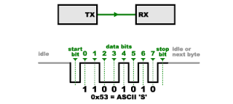
Rules of Asynchronous Serial, aka Serial
Number of built-in rules help ensure robust and error free data transfer
  Baud rate
  Data bits
  Synchronization bits
  Parity bits
Baud rate
  Specifies how fast data is sent over a serial line.
  Usually expressed in units of bits-per-second (bps)
  Determines how long the transmitter holds a serial line high/low or at what and period the receiving device samples its line
  Can be of any value, but both transmitter and receiver should have the same baud rate
  Standard baud rates are 1200, 2400, 4800, 9600, 19200, 38400, 57600, 115200
This Photo by Unknown Author is licensed under CC BY-SA
6

Slide 7
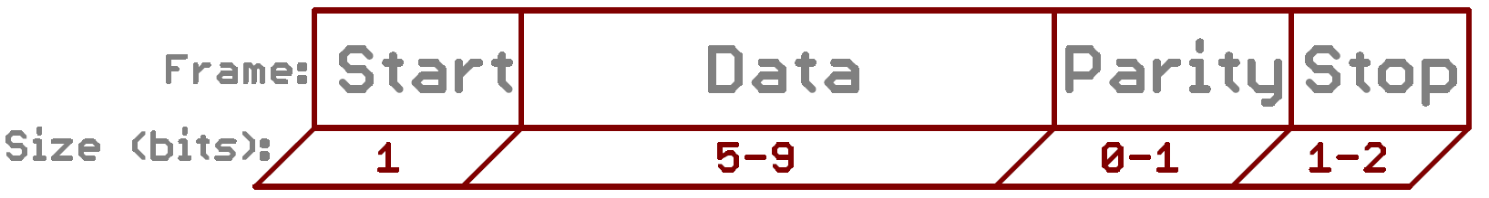
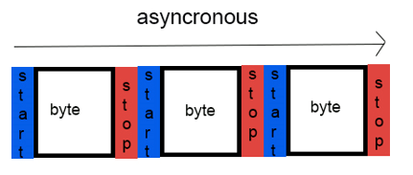
Data Packets in Serial transfer
Each block of data transmitted is actually sent in a frame of bits.
Data bits
  Amount of data in each frame can be from 5 to 9 bits
  It is important to agree on endianness (is data sent Most Significant Bit to Last Significant Bit or vice-versa?)
  If order not stated, default is LSB sent first
Synchronization bits
  Two or three special bits are transferred along with data bits
  Start bit marks the beginning of a data packet. Usually 1 bit
    Indicated by an idle data line going from 1 to 0
  Stop bit(s) marks the end of a data packet. Configurable to 1 or 2 bit, usually 1 bit.
    Indicated by stop bit(s) transition back to the idle state by holding the line at 1.
Source: Sparkfun
7
Notes:
Through the variety of these signaling mechanisms, you'll find that there's no one way to send data serially. The protocol is highly configurable. The critical part is making sure that both devices on a serial bus are configured to use the exact same protocols.
both serial devices also have to agree on the endianness of their data. Is data sent most-significant bit (msb) to least, or vice-versa? If it's not otherwise stated, you can usually assume that data is transferred least-significant bit (lsb) first.

Slide 8
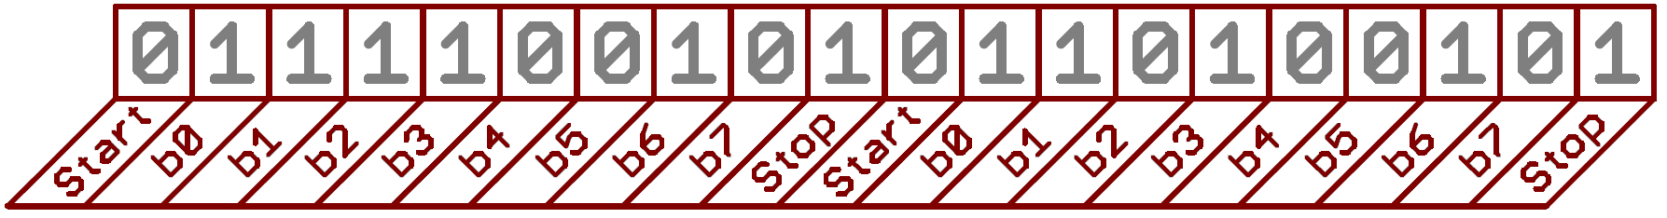
Data Packets in Serial transfer
Parity bits (Optional)
  A simple and low-level error checking method
  Options: Odd or Even parity
  Odd parity bit = 1 if the number of 1’s in data is odd
  Even parity bit = 1 if the number of 1’s in data is even
Example: 9600 8N1 OK
  Baud rate = 9600
  Data bits = 8
  Parity bits = No
  Stop bits = 1
  Data = OK
  O – ASCII Value = 79 = 01001111
  K – ASCII Value = 75 = 01001011
Source: Sparkfun
Source: Sparkfun
8

Slide 9
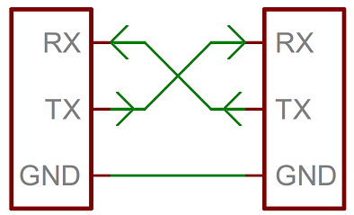
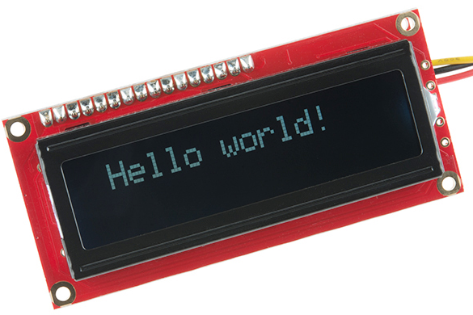
Serial – Wiring and Hardware
Serial bus consists of two wires
  TX – sends data
  RX – receives data
Interface can operate as full-duplex or half-duplex
  Full duplex – both devices can send and receive simultaneously
  Half duplex – devices must take turns sending and receiving
Some devices need only one way communication(simplex).
  Accordingly, only wire is visible
Source: Sparkfun
9

Slide 10
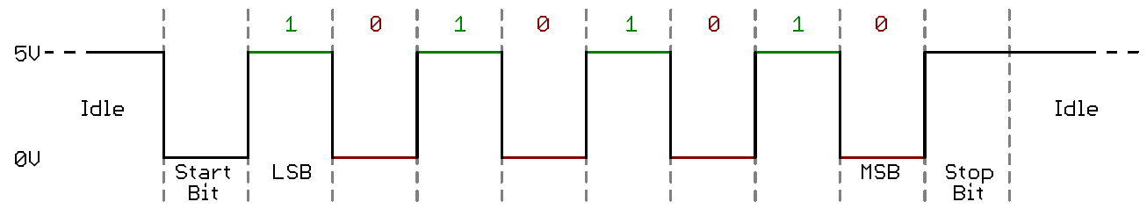
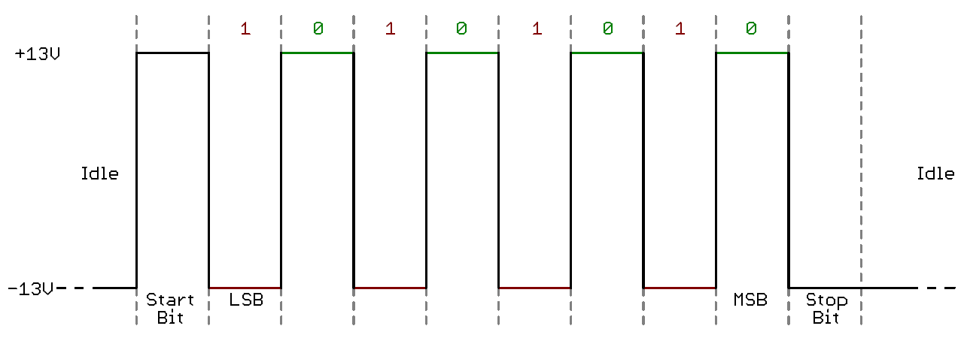
Serial – Hardware Implementation
Transistor-Transistor Logic (TTL)
  TTL serial signals exist between a microcontrollers’ voltage supply range (usually 0V to 3.3V or 5V)
  A signal at the VCC level indicates either an idle line, a bit of value 1, or a stop bit.
  A 0V (GND) signal represents either a start bit or a data bit of value 0.
  Easier to implement in embedded systems, but susceptible to losses across long transmission lines.
RS-232
  Usually found in old computers and legacy peripherals
  Usually range between -5V to +5V, though specs allow for anything from +/- 3V to +/- 25V.
  A low voltage indicates either the idle line, a stop bit, or a data bit of value 1.
  A high voltage indicates either a start bit, or a 0-value data bit.
  RS-485 is better suited to long range serial transmissions.
Source: Sparkfun
10

Slide 11
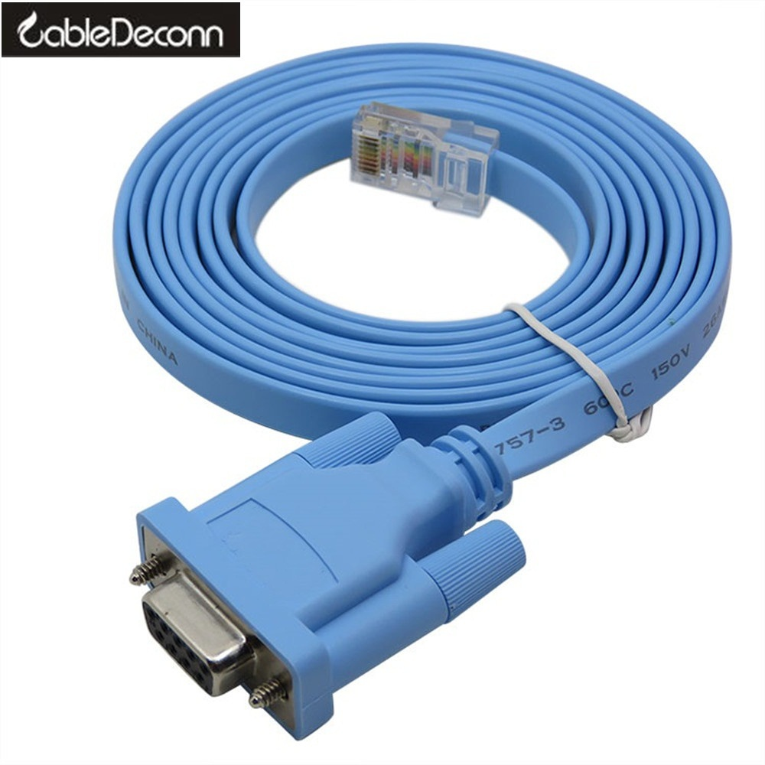
Asynchronous Serial (RS232)
Used for 1-to-1 communication
Many variants, simplest just uses 2 lines.
Often used for console access to configure Network Routers

Slide 12
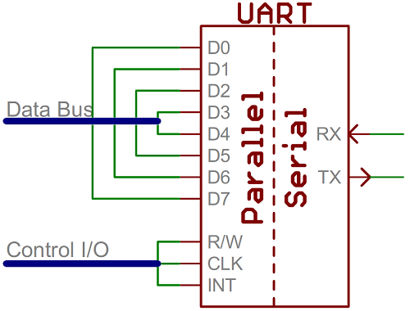
Universal Asynchronous Receiver/Transmitter - UART
UART is a block of circuitry responsible for implementing serial communication.
UART acts as an intermediary between parallel and serial interfaces.
Available as standalone ICs, but generally integrated inside a microcontroller.
On the transmit side, a UART must create the data packet and send it out with precise timing.
On the receive side, a UART has to sample RX lines, and extract the data from the packet received
Source: Sparkfun
12
Notes:
The final piece to this serial puzzle is finding something to both create the serial packets and control those physical hardware lines. Enter the UART.
More advanced UARTs may throw their received data into a buffer, where it can stay until the microcontroller comes to get it. UARTs will usually release their buffered data on a first-in-first-out (FIFO) basis. Buffers can be as small as a few bits, or as large as thousands of bytes.
If a microcontroller doesn't have a UART (or doesn't have enough), the serial interface can be bit-banged - directly controlled by the processor.
12

Slide 13
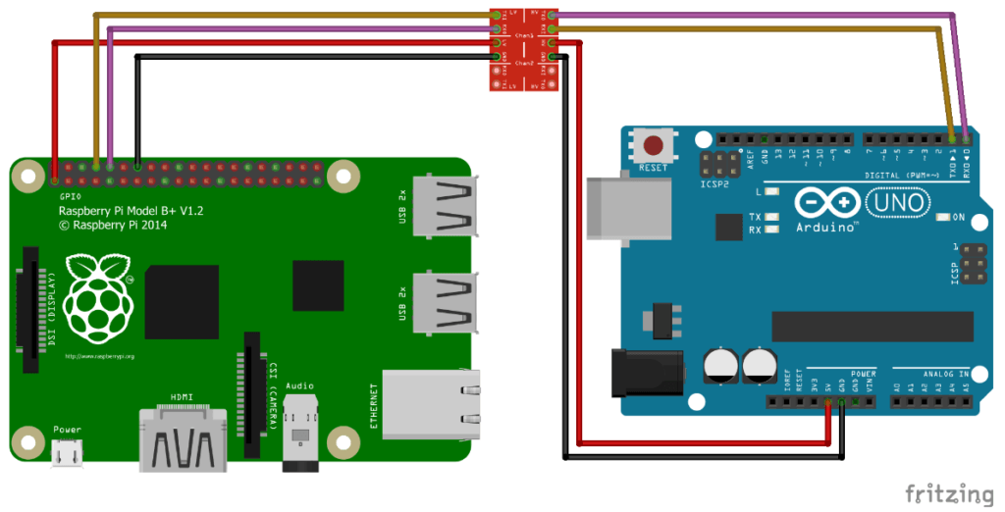
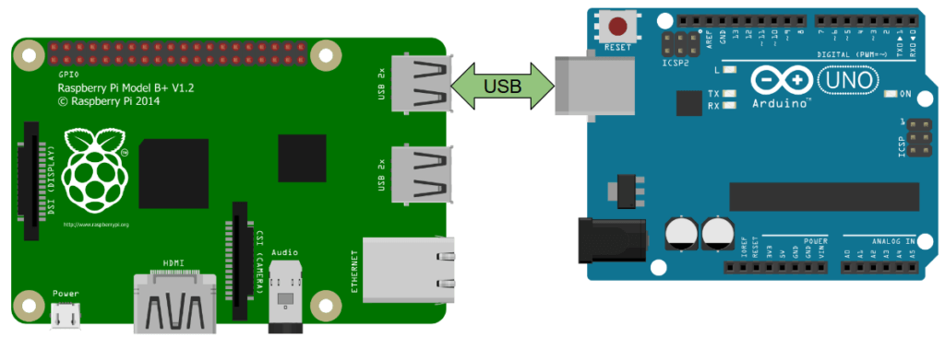
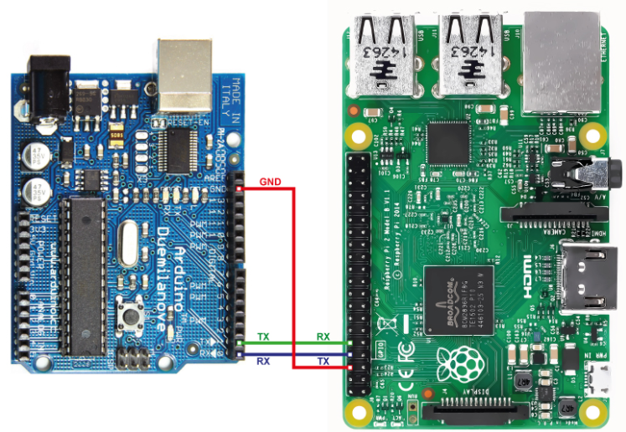
Raspberry Pi Serial Communication Examples

Slide 14
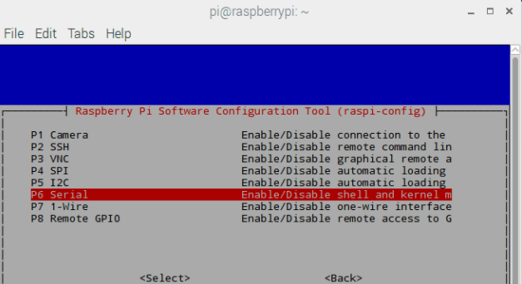
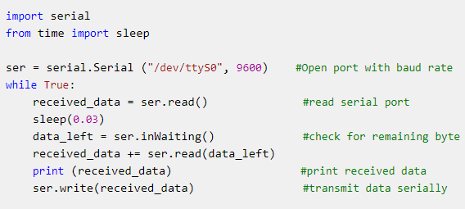
Demo: PySerial
Serial Communication uses a hardware interface “port” in programming
  May need some configuration in OS
Libraries to access, configure and use ports for serial comms
  handle all the low layers for you!
Notes:
When you connect an Arduino to a computer via USB and program it, the serial protocol being used is typically the Universal Serial Bus (USB) protocol itself for the physical connection. However, for data transmission, it primarily uses a virtual COM (Communication) port over USB, which emulates the RS-232 serial communication standard.

Slide 15
Synchronous Communication

Slide 16
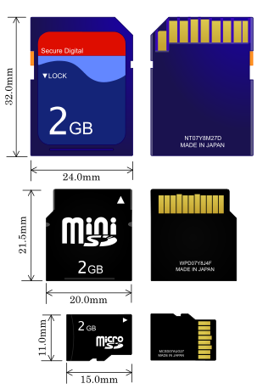
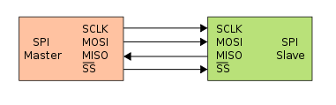
Serial Peripheral Interface (SPI)
Master and Slave Devices
  One master and multiple slaves
Used in liquid crystal displays, SD Cards, MPC3006 ADC
Master sets the speed
Signals
  SCLK: Serial Clock (output from master).
  MOSI: Master Output Slave Input, or Master Out Slave In (data output from master).
  MISO: Master Input Slave Output, or Master In Slave Out (data output from slave).
  SS: Slave Select (pulling line low selects slave, output from master).

Slide 17
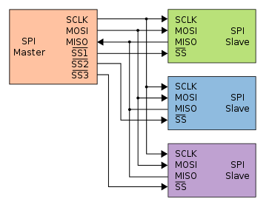
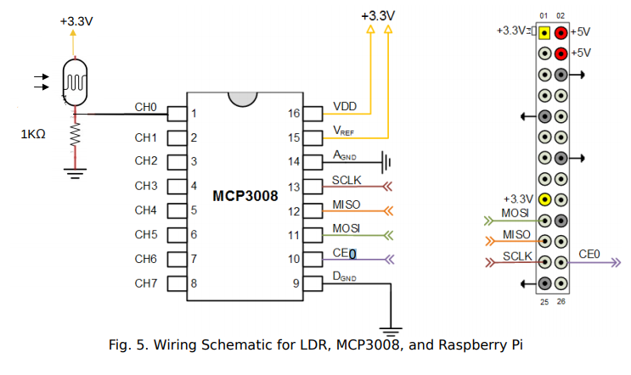
Serial Peripheral Interface (SPI)
Slave select line goes low to select slave
Full duplex data transmission occurs.
  The master sends a bit on the MOSI line and the slave reads it
  The slave sends a bit on the MISO line and the master reads it.
MCP3008 Analog to Digital converter uses it
https://www.microchip.com/wwwproducts/en/MCP3008

Slide 18

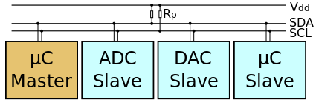
I²C (Inter-Integrated Circuit)
Also referred to as 2-wire bus.
  Clock(SCL) and Data(SDA)
Used for connecting lower-speed devices to processors and microcontrollers
Master-slave approach.
Unlike SPI, uses addressing instead of physical Slave Select lines (hence only 2 wires).
Speeds: 100kbs, 400kbs, 1Mbs and 3.4Mbs

Slide 19
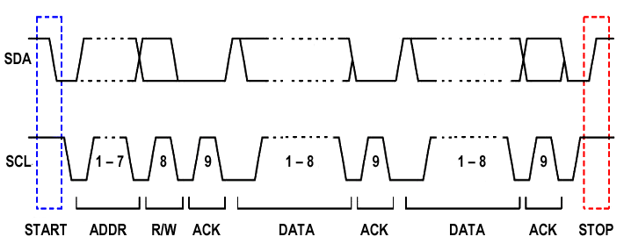
I²C (Inter-Integrated Circuit)
SDA,SLC start high
Master: SDA to low to signal start
Master: Send SCL with 7 bit address followed by 0 (for write)
Slave: pulls SDA to low for Acknowledgement
Master: sends 8 bit data on SDA
Slave: Acknowledgement
All: allow SDA, when SCL is high to Stop
https://www.youtube.com/watch?v=qeJN_80CiMU

Slide 20
I²C (Inter-Integrated Circuit)
You can transfer multiple bytes consecutively

Slide 21
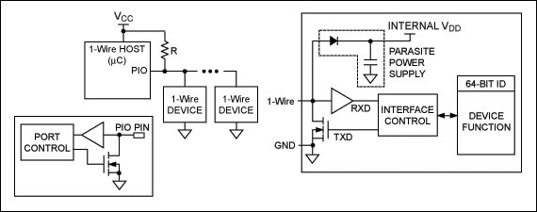
1-Wire
provides low-speed data, signaling, and power over a single wire.
Similar to I²C, but lower data rates and longer range.
Despite the name, you need 2 wires:
  Data and ground.
Because there’s no power(Vcc line), 1-Wire devices use capacitors to store power
  Parasitic device – takes power from bus.
  power the device when the data line is active

Slide 22
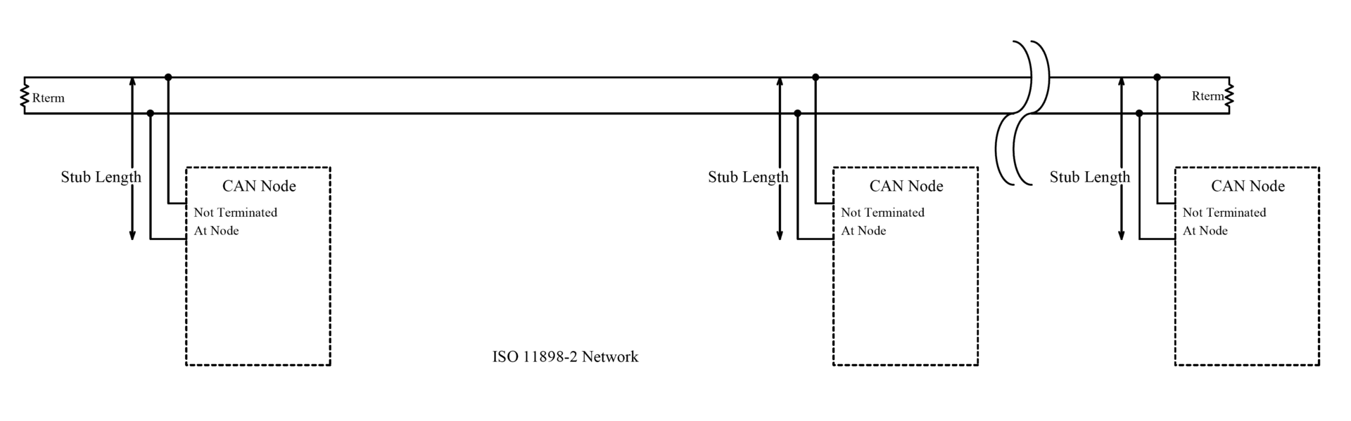
CAN (Controller Area Network)
A Controller Area Network (CAN bus) allows microcontrollers and devices to communicate with each other.
Predominantly used in Automotive
  Also in aviation/industrial
No Master-Slave, it’s mutli-master
  Any node can initiate comms.
All nodes are connected to each other through a two wire bus

Slide 23
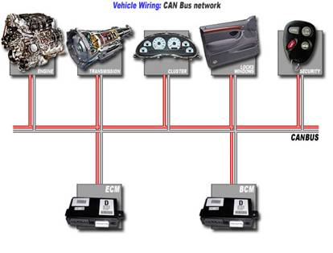
CAN (Controller Area Network)
CAN reduces wiring requirements
Robust protocol with built in fault tolerance
Reliable
  That’s why it’s the defacto protocol in automotive
Relatively straight forward protocol to understand….

Slide 24

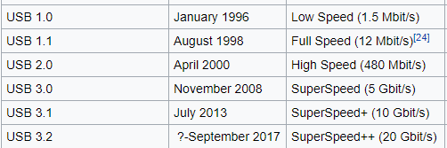
Universal Serial Bus (USB)
USB resulted from mixture of connection methods used on PCs
  Serial ports (modems)
  Parallel ports (printers)
  PCI (keyboards and Mice)
Now it’s “defacto”
Low speed
  Mice, keyboards
Full speed
  Other devices
High speed
  USB 2.0, media devices
USB 3.0…
Used for all sorts of stuff!!!

Slide 25
